Slide 1
Introduction
Time series forecasting of the covid cases
Github link of our project: https://github.com/bavanya/covid-19_tracker_data_mining
BY:
18075020: Ganji Spandana
18075032: Kunapareddy Pooja Naidu
18075034: Kurra Bavanya Choudhry
18075037: Madhulika Damor

Slide 2
Time Series Forecasting of covid cases

Slide 3
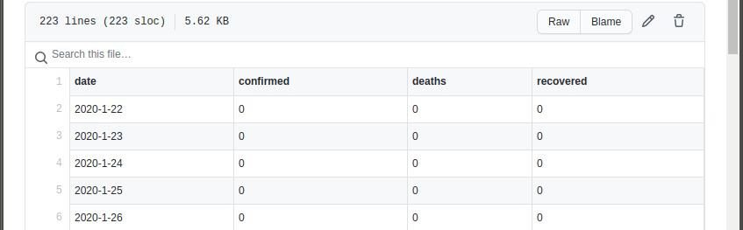
Collecting Time Series data
Data Source 1:The open source project https://github.com/pomber/covid19 provides the covid time series data in a json file, which is collected through https://pomber.github.io/covid19/timeseries.json. Using requests package in python, we collected the json file and placed the data of India into a csv file.

Slide 4
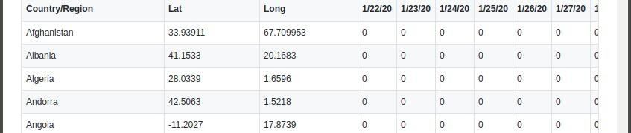
Collecting Time Series data
Data source 2: Directly took the csv files of global and US time series cases data from https://github.com/CSSEGISandData/COVID-19. There are separate csv files for confirmed cases, deaths and recovered cases for global and US.

Slide 5
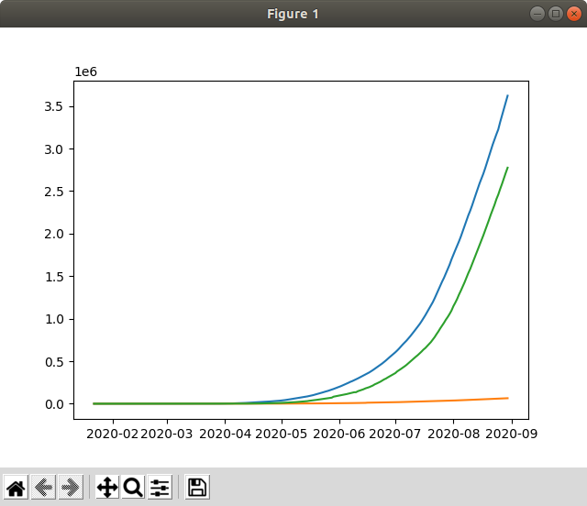
Data Visualization
The following visualization is done using matplotlib library in python:
This plot visualizes the rise in the total number of cases till date from 2020-01-22.

Slide 6
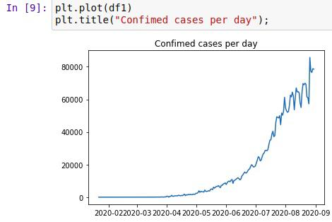
Data Visualization
The confirmed cases, deaths an recovered cases discovered on each day are obtained from the time series data and the following visualization is obtained: using matplotlib

Slide 7
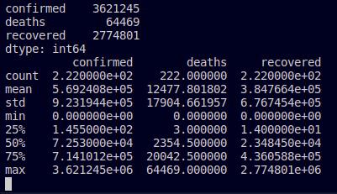
Data Analysis
Other aggregation data is as follows: This is obtained from the read_csv() and describe() functions in python

Slide 8
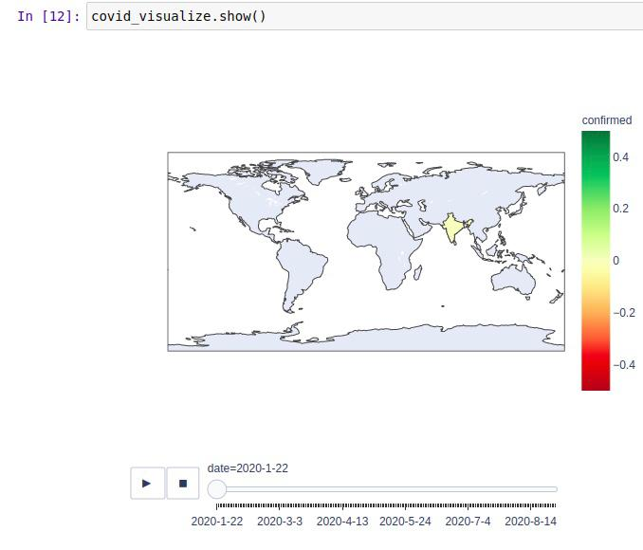
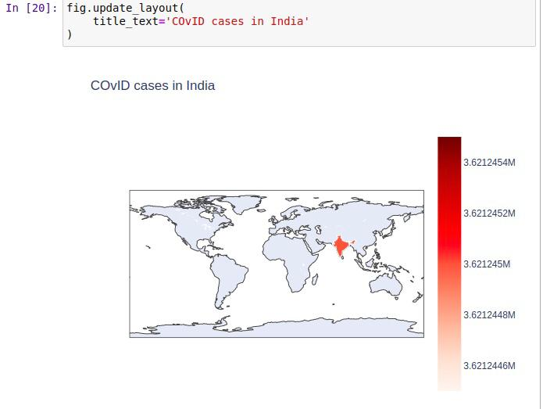
Map Visualization
Used plotly and pycountry packages in python

Slide 9
Data preprocessing
1. Checked whether any entry in the dataframe has null value using dataframe.isnull().sum().sum()
2. Changed the data type of data column to datetime, using pandas.to_datetime()
3. Used MinMaxScaler() to scale the training and testing data

Slide 10
Different Techniques followed
1. Traditional machine learning methods like linear regression and support vector machines
2. Using Neural Networks: Multiple layer perceptron
3. Statistical models like: ARIMA Model (AutoRegressive Integrated moving average model)
4. Using Advanced neural networks like LSTM (Long short term memory networks)

Slide 11
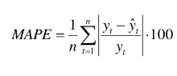
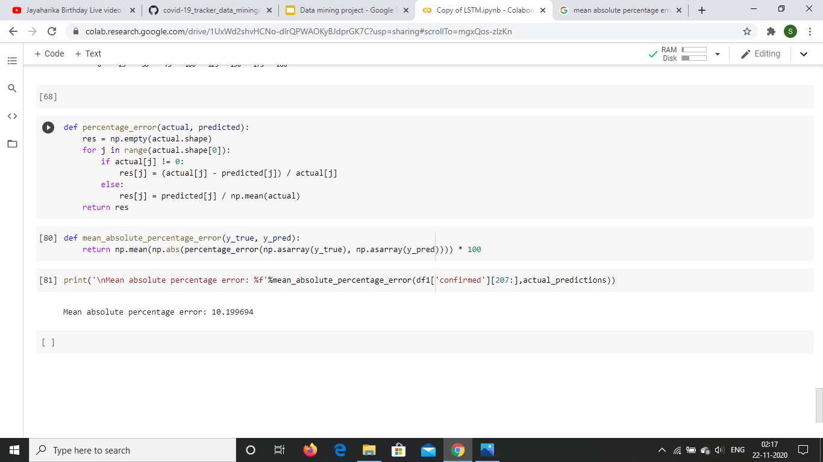
Evaluation metric chosen
Mean absolute percentage error

Slide 12
ARIMA Model
Used stats models package(https://github.com/statsmodels/statsmodels) for:
Plotting
rolling mean
standard deviation
ACF and PACF
Dickey fuller test
Arima modelling

Slide 13
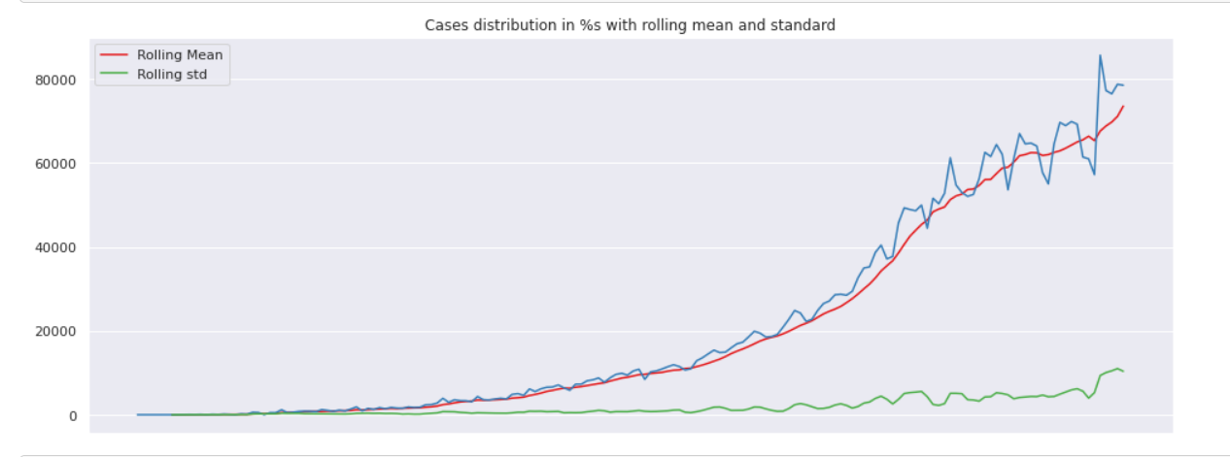
Rolling mean and standard deviation
15 Data samples are taken for testing and 207 samples for training.
To study the stationarity of the time series data, the rolling mean and standard deviation are plotted:

Slide 14
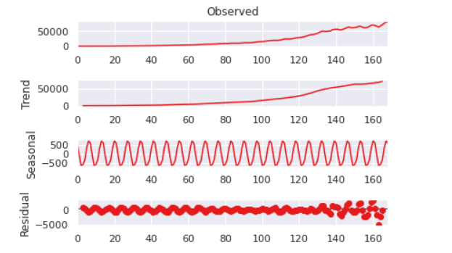
Seasonal And Residual properties
We find the seasonal and residual properties by decomposing the dataset.

Slide 15
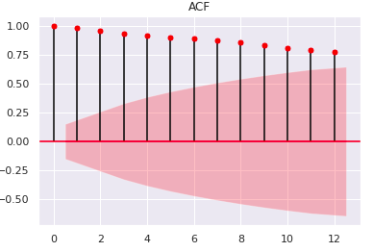
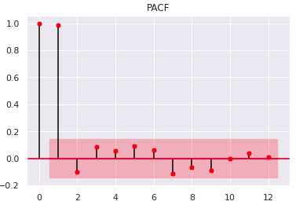
ACF and PACF
The ACF and PACF plots give an approximate value for the p and q values to use in the ARIMA model.

Slide 16
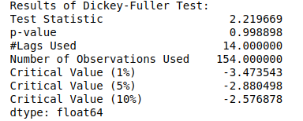
Dickey Fuller test
The test result gives the p-value is above the critical value at even 5%. So it is assumed that the series has a unit root. Hence differencing the series gives proper stationary series.

Slide 17
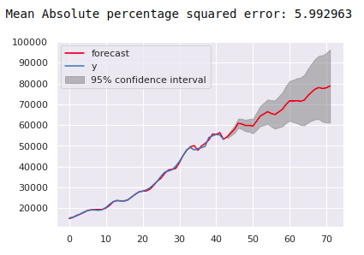
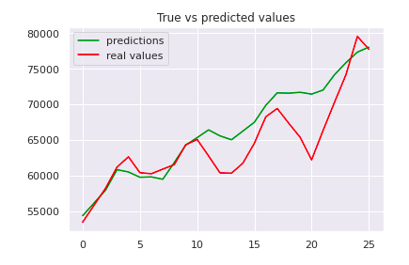
ARIMA model Results

Slide 18
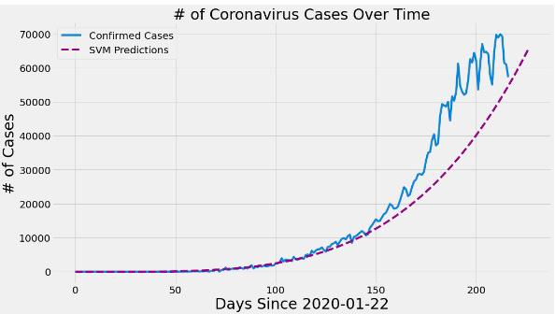
Machine learning techniques
1. Support vector machines
Used sklearn for implementation.
Imported SVR from sklearn.svm with parameters as:
kernel='poly'
gamma=0.01
epsilon=1
degree=4
C=0.2

Slide 19
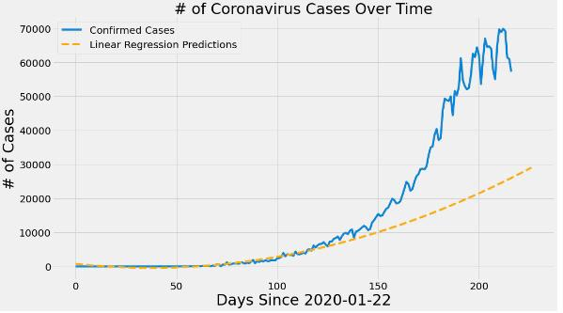
Machine learning techniques
2. Linear Regression
Used sklearn for implementation.
Imported LinearRegression from sklearn.linear_model
Imported PolynomialFeatures from sklearn.preprocessing with degree=2.

Slide 20
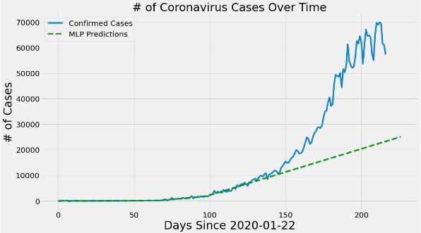
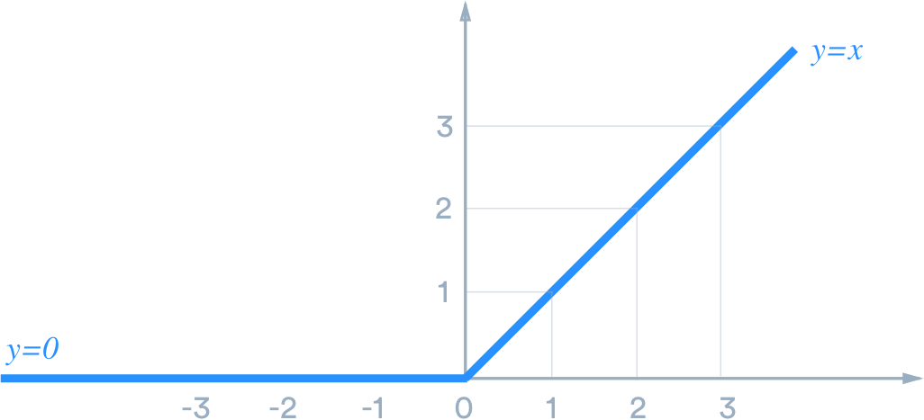
Multiple Layer Perceptron
Used sklearn for implementation.
Imported MLPRegressor from sklearn.neural_network with: (default relu activation taken)
solver='lbfgs' (an optimizer)
max_iter=500

Slide 21
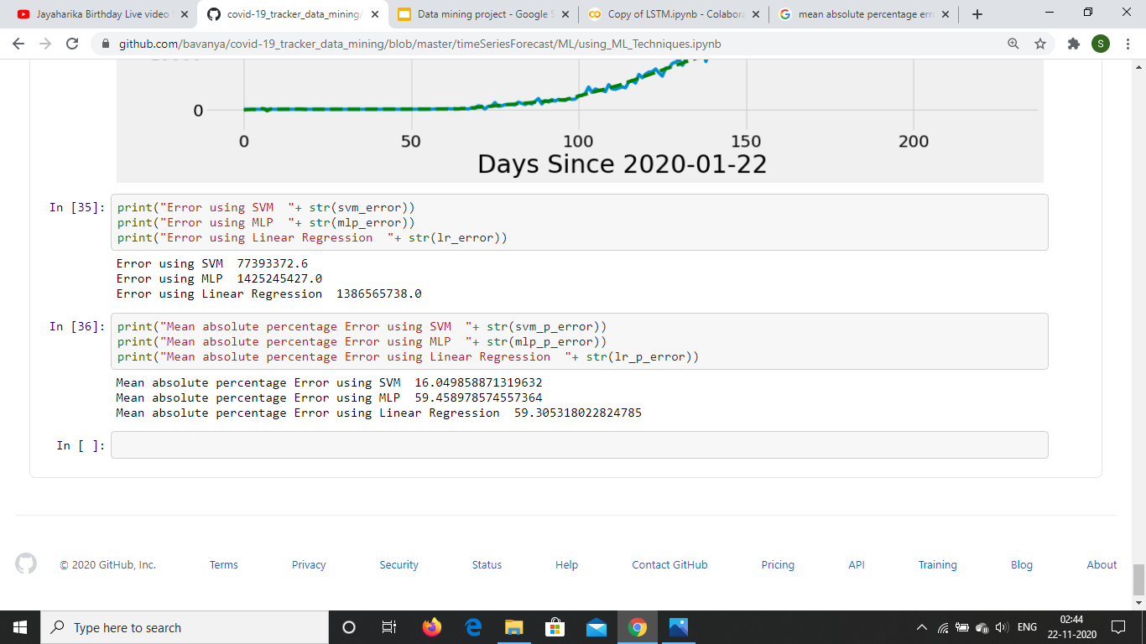
Performance of ML models
By using sklearn.metrics, the mean absolute percentage error is obtained for the following three models.

Slide 22

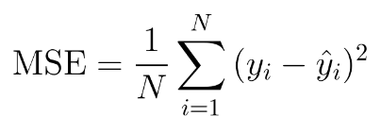
LSTM Model
MinMaxScaler() from sklearn is used for Min Max scaling.
nn.LSTM() is used from torch package to build the model and nn.module is used to initialize the hyper parameters.
nn.MSELoss() is used for the loss function.
optim.Adam() is used for the optimizer.

Slide 23
Overview
The test train split is taken as 93% and 7%.
The data is normalised using MinMaxScaler().
For training the model, the train window size is taken as 12.
The LSTM model class consists of two parts:
constructor - initialize all helper data and create the layers
Forward function- Get the sequences, pass all of them through the LSTM layer, at once. We take the output of the last time step and pass it through our linear layer to get the prediction.
Mean squared error is taken as the loss function.
Adam optimizer is used.
All the weights are initialized with zeros.

Slide 24
Model description
The hyperparameters taken are:
# of epoch=150
learning rate=0.001
input_size=1
hidden_layer_size=100
output_size=1

Slide 25
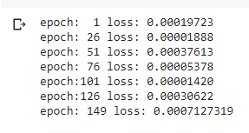
Training and MSE loss at epochs
Loss observed for training data

Slide 26
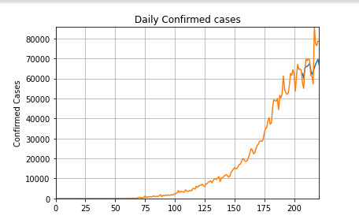
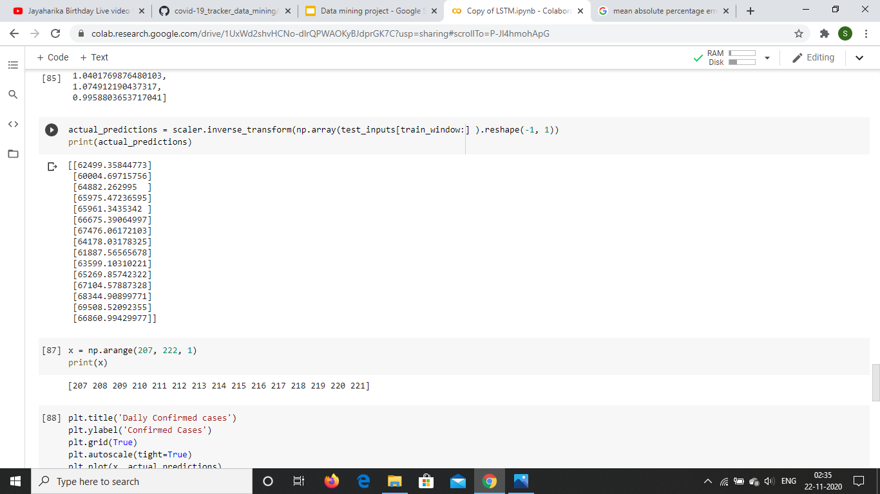
LSTM Model Results

Slide 27
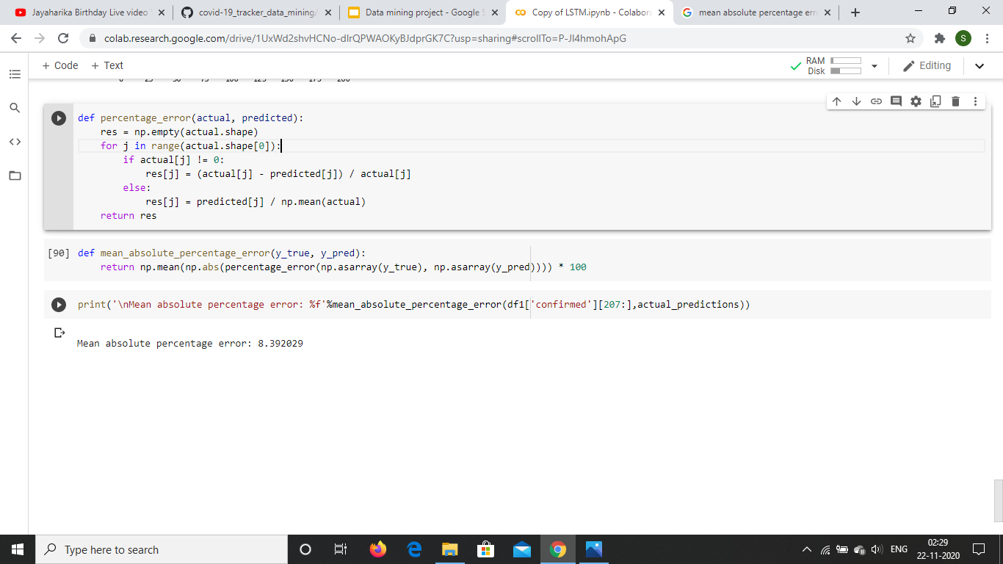
Performance of the LSTM model

Slide 28
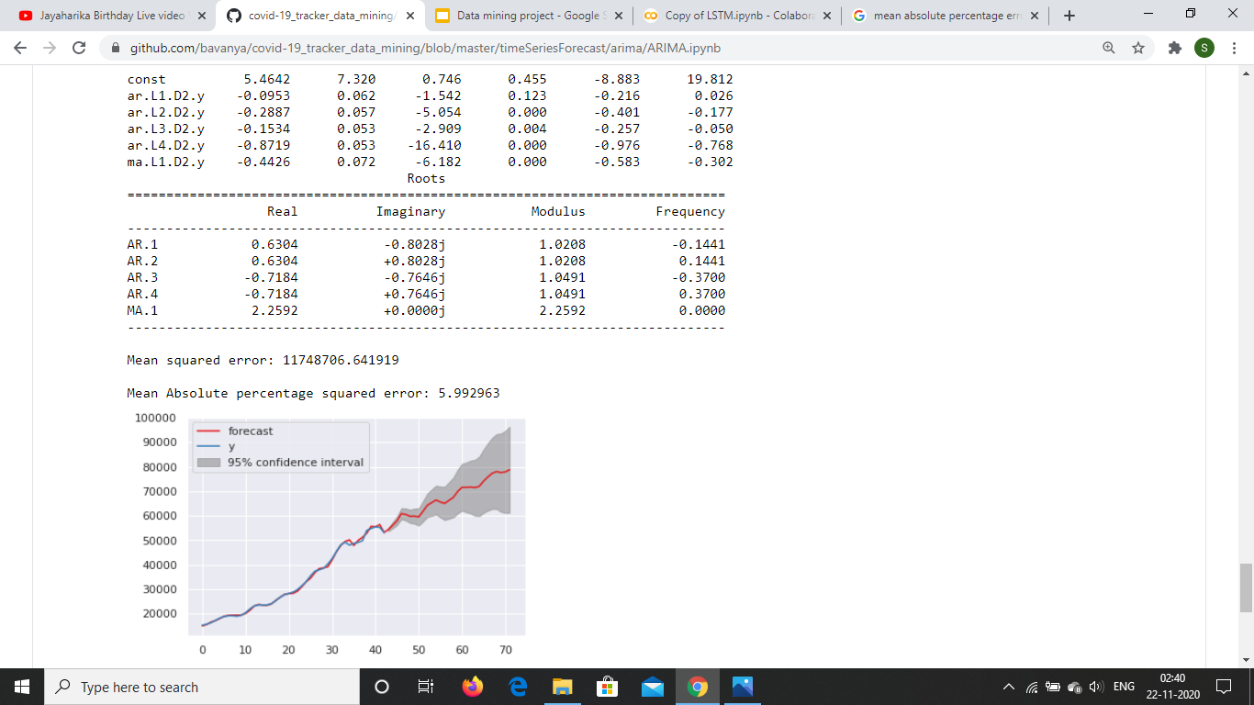
Comparison of Results
ARIMA
ML techniques
LSTM

Slide 29
Observations
The ARIMA gave the best results closely followed by the LSTM model. From the visualization of the predictions, it was observed that both ARIMA and LSTM learned the zonal behaviour and the trend and gave closer predictions.
Though MLP implements neural networks, it performed the least. It was not able to learn the behaviour of the time series properly because of the very few layers of neurons.
SVM gave better performance compared to Linear Regression as it was able to learn the trend of the series, whereas Linear Regression only learned that the series was on rise and tried to adjust the slope of the predictor line accordingly.
Models other than LSTM and ARIMA were poor in learning the seasonal factors as the seasonality and the white noise are ignored.

Slide 30
Thank you

